Slide 1


Runtime Power Gating of On-Chip Routers
Using Look-Ahead Routing
Hiroki Matsutani (Keio Univ, Japan)
Michihiro Koibuchi (NII, Japan)
Daihan Wang (Keio Univ, Japan)
Hideharu Amano (Keio Univ, Japan)

Slide 2
Background: Leakage & Power gating
Leakage power
  Major component of
  Standby power
Power gating (PG)
  Leakage power reduction
  Turning on/off the power supply to the circuit block
Examples of PG
  Processor core
  Execution unit
  ALU, FPU, MAC, …
Dynamic
Leakage (60.9%)
e.g., Standby power of on-chip router
(90nm CMOS; 200MHz)
Vdd
Power switch
Virtual Vdd
Circuit block
GND
We focus on power gating to reduce standby power of NoCs

Slide 3
Outline
Network-on-Chip (NoC)
On-Chip Router
  Architecture
  Power consumption
Runtime power gating of routers
  Overheads
  Look-Ahead sleep control
Evaluations
  Performance penalty
  Compensated sleep cycles
  Leakage reduction

Slide 4
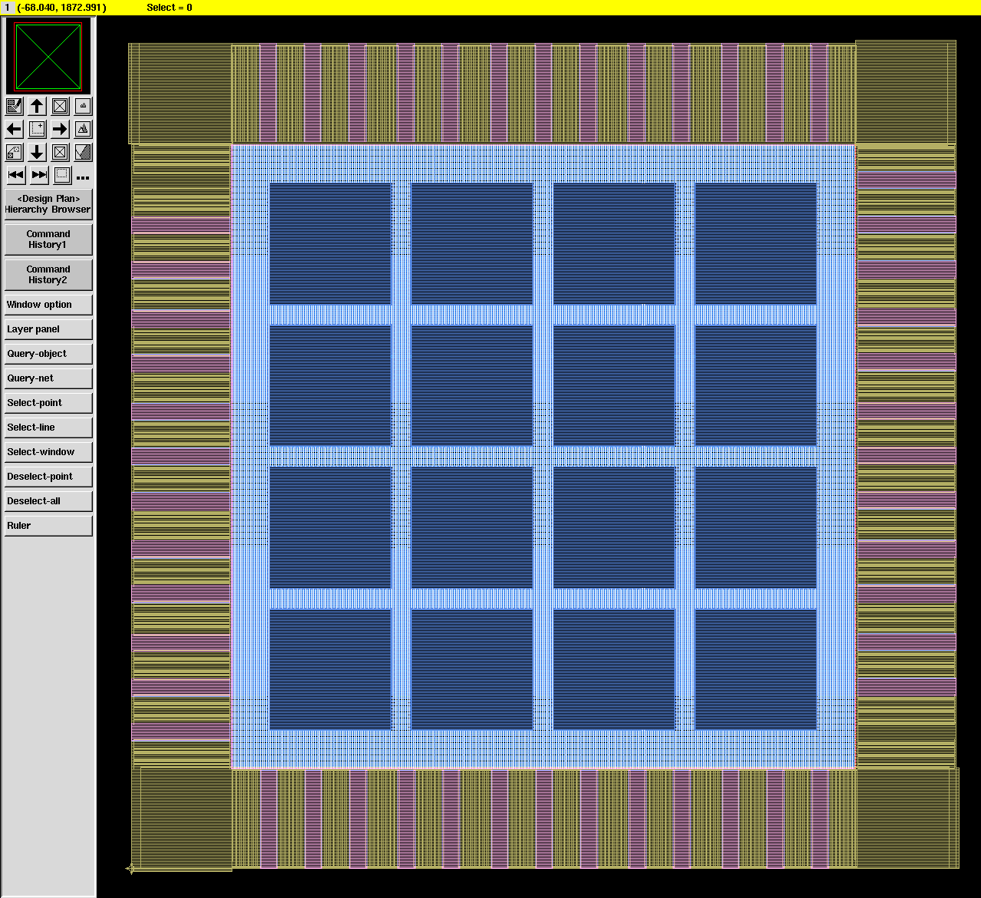
Network-on-Chip (NoC)
Processor core
On-chip router
Processor core
Router
An example tile architecture (ASPLA 90nm CMOS)

Slide 5
Network-on-Chip (NoC)
Processor core
  Largest component
  Various low-power techniques are used
On-chip router
  Area is not so large
  Infrastructure that affects on-chip communication
D
Stop!!
e.g., Standby current 11uA
[Ishikawa,IEICE’05]
S
Stopping routers makes a topology “irregular”
An example tile architecture (ASPLA 90nm CMOS)
The next slides show “Router architecture” and “Its power”

Slide 6
On-Chip Router: Architecture
5-input 5-output router (data width is 64-bit)
Two virtual channels (64-bit x 4 x 2)
ARBITER
X+
FIFO
X+
X-
FIFO
X-
Y+
FIFO
Y+
Y-
FIFO
Y-
5x5 XBAR
CORE
FIFO
CORE
HW amount is 34 kilo gates and 64% of area is used for FIFO

Slide 7
On-Chip Router: Pipeline
A header flit goes through a router in 3 cycles
  RC (Routing Computation)
  SA (Switch Allocation)
  ST (Switch Traversal)
E.g., Packet transfer from router A to C
Packet size is 4-flit including 1-flit header
@ROUTER A
@ROUTER B
@ROUTER C
HEAD
RC
SA
ST
RC
SA
ST
RC
SA
ST
DATA 1
ST
ST
ST
DATA 2
ST
ST
ST
DATA 3
ST
ST
ST
1
2
3
4
5
6
7
8
9
10
11
12
ELAPSED TIME [CYCLE]

Slide 8
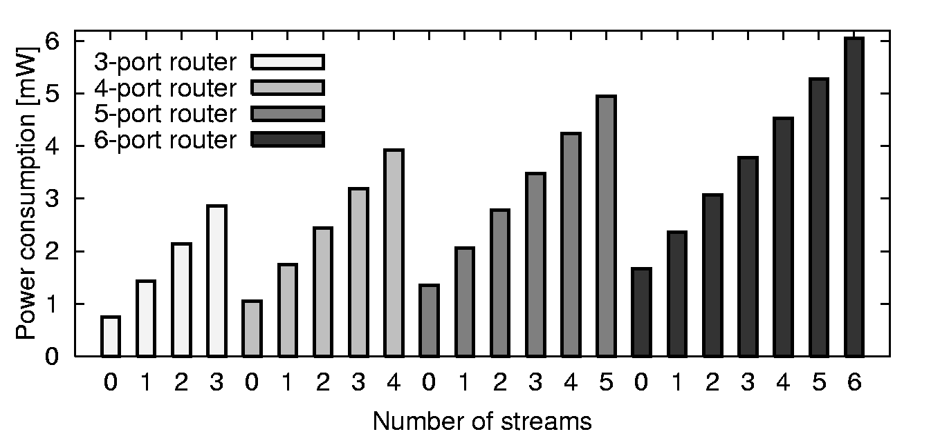
On-Chip Router: Power consumption
Place-and-routed with 90nm CMOS
Post layout simulation at 200MHz
Power consumption of a router when n ports are used [mW]
A router consumes more power as the router processes more packets

Slide 9
On-Chip Router: Power consumption
Power consumption when no port is used → standby power
Leakage (60.1%)
Dynamic (39.9%)
Channels (54.0%)
Leakage of channel bufs is the largest; it should be reduced
Standby power of the on-chip router

Slide 10
Outline
Network-on-Chip (NoC)
On-Chip Router
  Architecture
  Power consumption
Runtime power gating of routers
  Overheads
  Look-Ahead sleep control
Evaluations
  Performance penalty
  Compensated sleep cycles
  Leakage reduction

Slide 11
On-Chip Router: Leakage reduction
Runtime power gating of router channels
  No packets in a channel → Sleep
  Packet arrives at the channel → Wakeup
ARBITER
X+
FIFO
X+
X-
FIFO
X-
Y+
FIFO
Y+
FIFO
Y-
FIFO
Y-
5x5 XBAR
CORE
FIFO
CORE

Slide 12
On-Chip Router: Leakage reduction
Runtime power gating of router channels
  No packets in a channel → Sleep
  Packet arrives at the channel → Wakeup
ARBITER
X+
FIFO
X+
X-
FIFO
X-
Y+
FIFO
Y+
FIFO
FIFO
Y-
FIFO
Y-
Link shutdown has been studied for on- & off-chip networks, but prior work uses SRAM buffers [Chen,ISLPED’03] [Soteriou,TPDS’07]
→We use small registered FIFOs for light-weight NoC routers
5x5 XBAR
CORE
FIFO
CORE

Slide 13
Power Gating: Various overheads
Pipeline stall of a router occurs
Area overhead
  Power switches
Performance overhead
  Wakeup delay
  Pipeline stall is caused
Power overhead
  Driving power switches
  Short sleeps adversely increases dynamic power
Sleep
Active
FIFO
FIFO
Waiting for channel wakeup
→Early detection of packet arrivals
→Detect & avoid short-term sleeps

Slide 14
Power Gating: Various overheads
Pipeline stall of a router occurs
Area overhead
  Power switches
Performance overhead
  Wakeup delay
  Pipeline stall is caused
Power overhead
  Driving power switches
  Short sleeps adversely increases dynamic power
Sleep
Active
FIFO
FIFO
Waiting for channel wakeup
Vdd
Power switch
→Early detection of packet arrivals
sleep
Virtual Vdd
Circuit block
→Detect & avoid short-term sleeps
GND
Sleep control that detects arrival of packets early is needed

Slide 15
Look-Ahead Sleep Control
Look-ahead sleep control
  To mitigate the wakeup delay and short-term sleeps
Normal routing:
  Router i calculates the output port of Router i
Look-ahead routing:
  Router i calculates the output port of Router i+1
Five-cycle margin until packet arrival
R0
R1
R2
RC
SA
ST
RC
SA
ST
RC
Look-Ahead:
R2 detects a packet arrival when the packet arrives at R4
R3
R4
R5
ST
ST
ST
Packet will arrive after two hops
R6
R7
R8
ST
Eg., A packet goes through R3, R4, R5, and R2
Look-ahead can eliminate a wakeup delay of less than 5-cycle
Router 4
Router 5
Router 2

Slide 16
Outline
Network-on-Chip (NoC)
On-Chip Router
  Architecture
  Power consumption
Runtime power gating of routers
  Overheads
  Look-Ahead sleep control
Evaluations
  Performance penalty
  Compensated sleep cycles
  Leakage reduction

Slide 17
Evaluations: Sleep control methods
Evaluation items
  Network throughput
  Leakage reduction
Parameters
Ideal method
  Ideal case
  No wakeup delay
Look-ahead method
  Detects packet arrival 5-cycles ahead
Naïve method
  Original router
  No look-ahead
Topology | 2-D Mesh (4x4)
Routing | DOR (XY routing)
Packet size | 5-flit (1-flit header)
Buffer size | 4-flit (WH switching)
# of VCs | 2 VCs
Latency | 3-cycle per 1-hop
Traffic pattern:
Uniform and NPB programs (BT,SP,CG,MG, and IS)

Slide 18
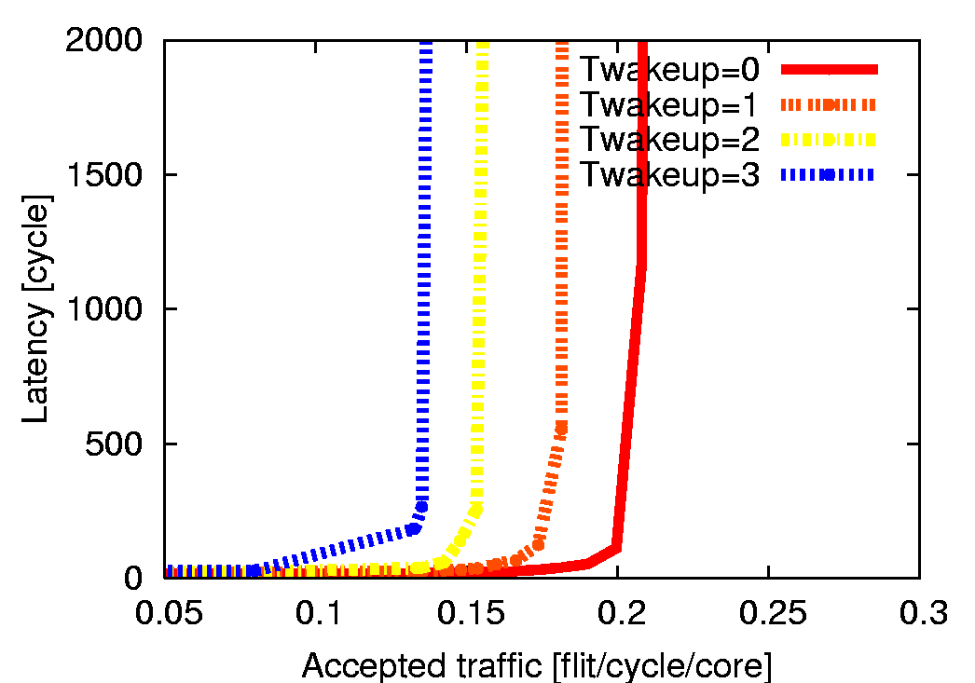
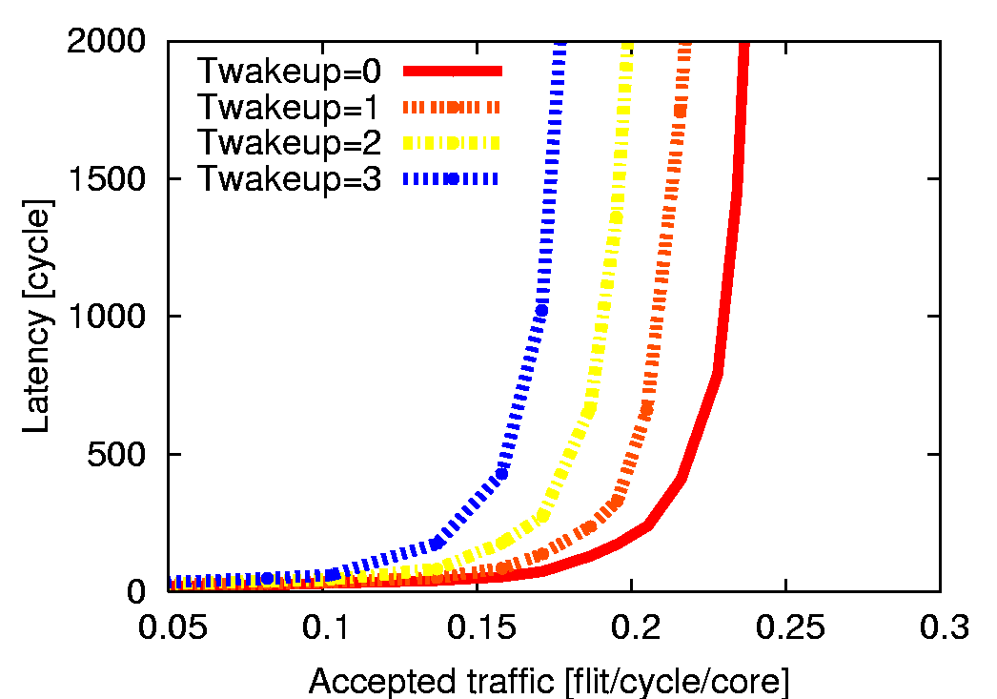
Evaluations: Performance of “naïve”
Throughput on various wakeup delays (e.g., 0,1,2,3 cycles)
  Naïve:
Performance is reduced as Twakeup increases
Uniform traffic (16-core)
MG.W traffic (16-core)

Slide 19
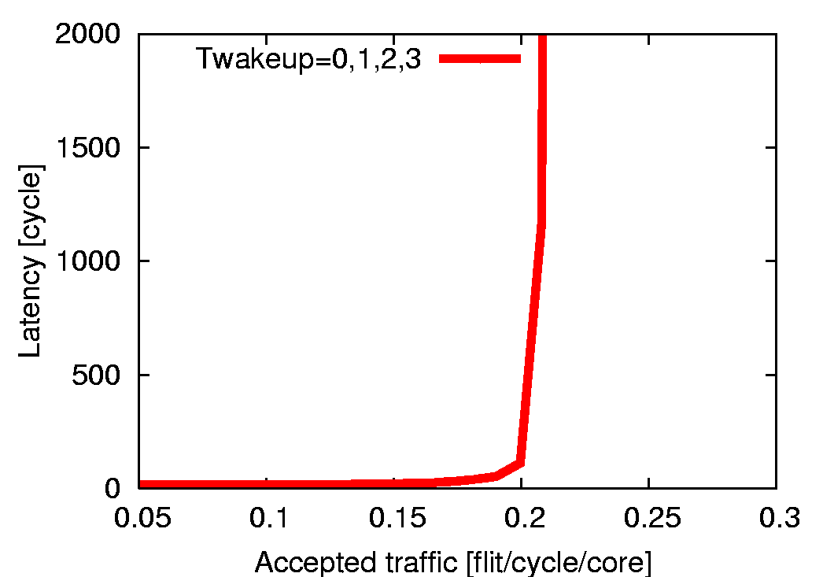
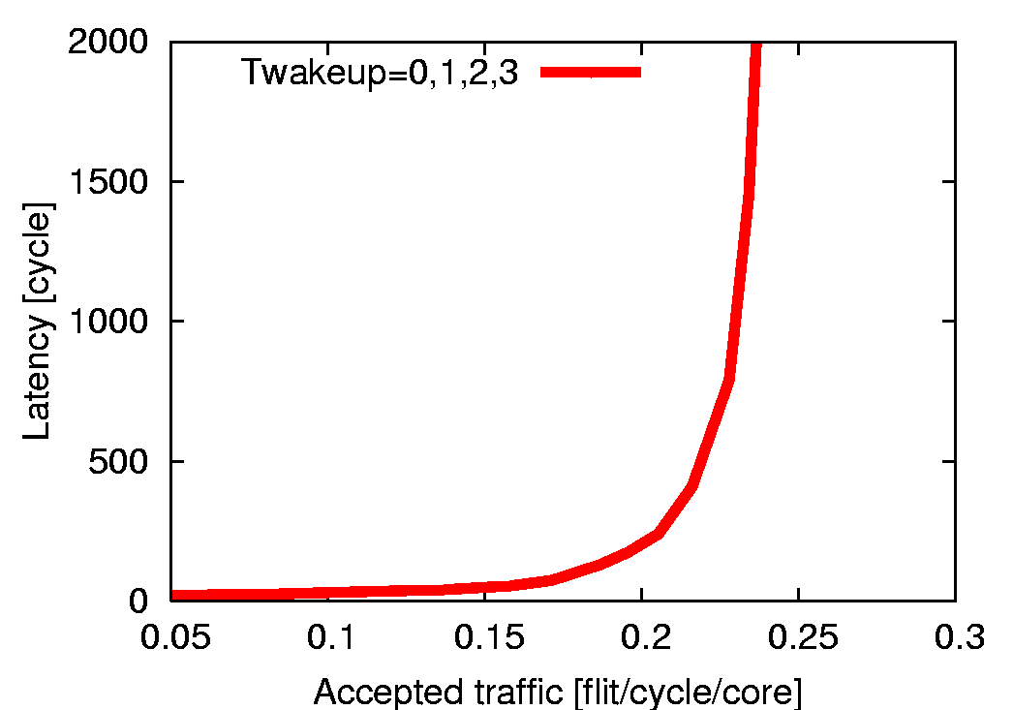
Evaluations: Performance of “lookahead”
Throughput on various wakeup delays (e.g., 0,1,2,3 cycles)
  Naïve:
  Ideal:
  Look-ahead:
Performance is degraded as Twakeup increases
Same as regardless of Twakeup
Same as if Twakeup is less than 5
Uniform traffic (16-core)
MG.W traffic (16-core)
Look-ahead can conceal a wakeup delay of less than 5 cycles

Slide 20
Evaluations: Breakeven point of PG
Power gating model
  Eoverhead: Power consumed for turning PS on/off
  Esaved: Leakage power saving for an N-cycle sleep
[Hu,ISLPED’04]
How many cycles are required to sleep for compensating Eoverhead ?
We calculate the breakeven point of PG based on the following parameters
Supply voltage | 1.0 V
Switching factor | 0.10
Leakage power | 95 uW
Dynamic power (200MHz) | 105 uW
Dynamic power (500MHz) | 261 uW
Power switch size ratio | 0.1
Power switch cap ratio | 0.5
Based on the post layout simulation of on-chip router (90nm CMOS)

Slide 21
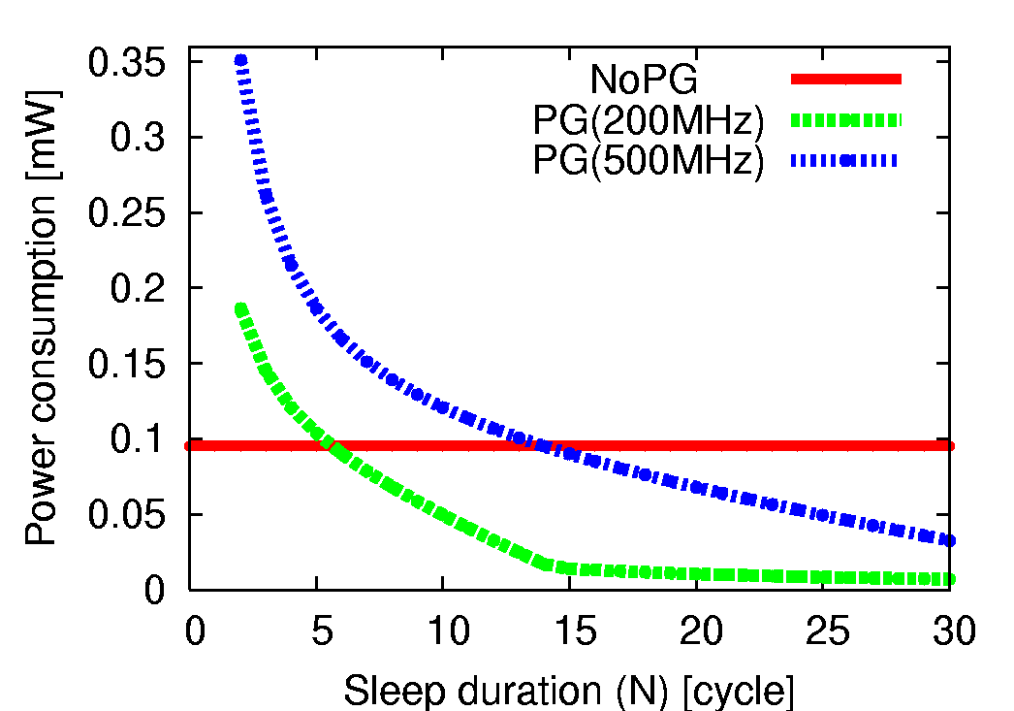
Evaluations: Breakeven point of PG
Power gating model
  Eoverhead: Power consumed for turning PS on/off
  Esaved: Leakage power saving for N-cycle sleep
[Hu,ISLPED’04]
How many cycles are required to sleep for compensating Eoverhead ?
Breakeven point is 6 cycle (200MHz)
Power consumption is reduced as sleep duration becomes long
Breakeven point is 14 cycles (500MHz)
No power gating (PG)
PG router (200MHz)
PG router (500MHz)

Slide 22
Evaluations: Compensated sleep ratio
States of router channels
  Nactive: Active operation Power is consumed as usual
  Ncsc: Compensated sleep Sleep longer than Tbreakeven
  Nusc: Uncompensated sleep Sleep less than Tbreakeven
Estimate the ratio of compensated sleep cycles
  We performed the network simulation again
  Comparison between three sleep control methods
sleep
sleep
Nactive
Nusc
Ncsc
wakeup
Ideal, Look-ahead, Naïve

Slide 23
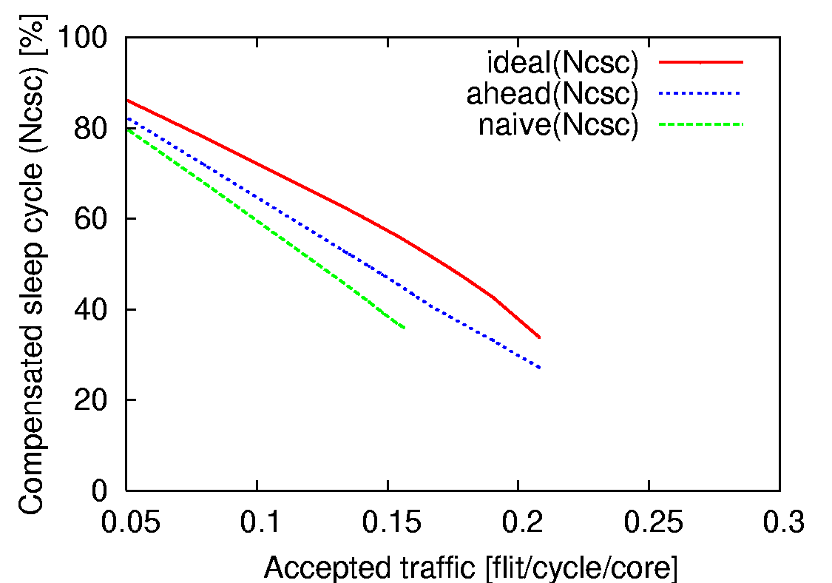
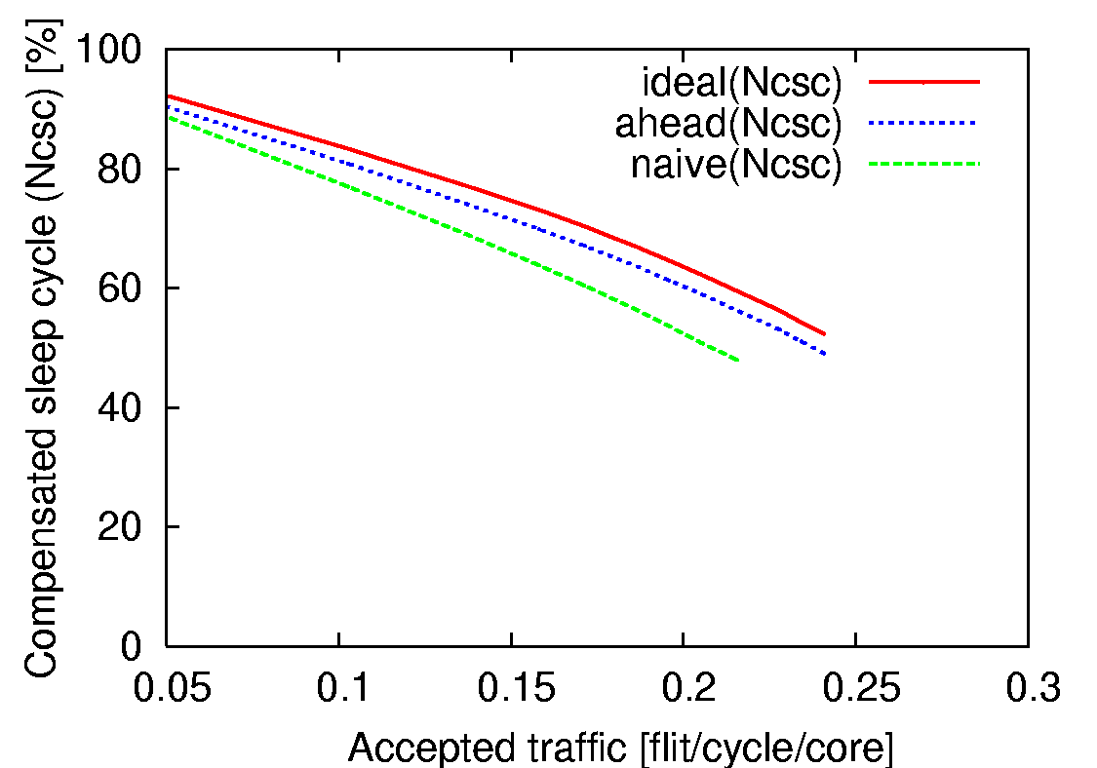
Evaluations: Compensated sleep ratio
States of router channels
  Nactive: Active operation Power is consumed as usual
  Ncsc: Compensated sleep Sleep longer than Tbreakeven
  Nusc: Uncompensated sleep Sleep less than Tbreakeven
Ncsc rate 80% (low workload)
Ncsc rate 25% (high workload)
Uniform traffic (16-core)
MG.W traffic (16-core)
Ncsc decreases as traffic increases; Ideal >Look-ahead >Naïve

Slide 24
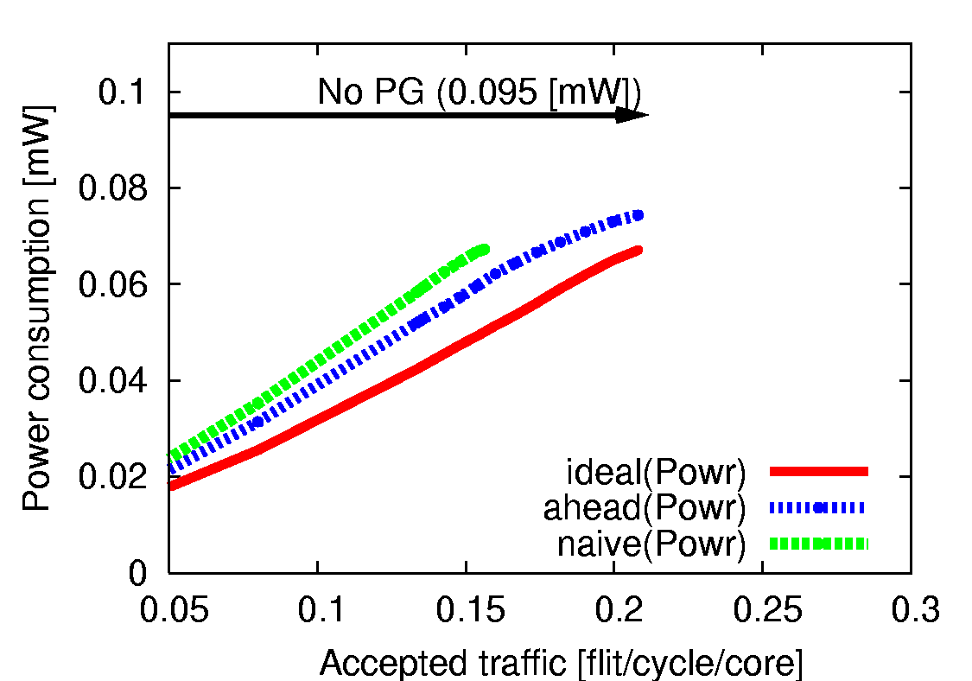
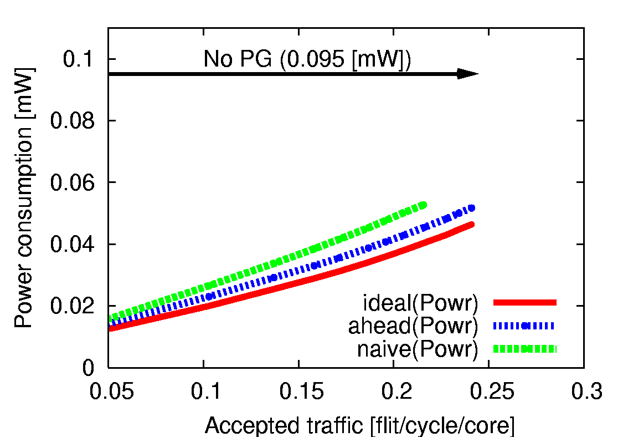
Evaluations: Leakage power reduction
Leakage power at each channel Tbreakeven = 6
  No power gating consumes 95 [uW]
  Leakage reduction of PG with 3 sleep control methods
This includes the overhead energy to turn on/off power switches
Leakage reduction
Uniform traffic (16-core)
MG.W traffic (16-core)
Leak increases as traffic increases; Ideal <Look-ahead < Naïve

Slide 25
Summary: Look-ahead sleep control
Runtime power gating of router channels
  Wakeup delay introduces pipeline stalls of routers
  Short-term sleeps overwhelm the leakage reduction
Look-ahead sleep control
  An extension of “look-ahead routing”
  Detects the arrival of packets five cycles ahead
Evaluation results
  Look-ahead conceals the wakeup delay of less than 5
  Look-ahead reduces more leakage compared with naive

Slide 26
Thank you for your attention

Slide 27
Backup sides

Slide 28
Look-ahead method: HW resources
Routing computation of next router
  Just changing the routing function
  Area overhead is very small
Wakeup signals are needed
  Sender asserts “wakeup” signal
  to receiver
  Wakeup signals becomes long
  Negative impact of
  multi-cycle or repeater buffers
NRC stage: Next Routing Computation
HEAD
NRC
SA
ST
NRC
SA
ST
NRC
SA
ST
DATA 1
ST
ST
ST
DATA 2
ST
ST
ST
0
1
2
3
4
5
6
7
8
Wakeup signals to router 1

Slide 29
Wakeup delay: Performance impact
Wakeup delays in literatures
  ALU: 2 cycle AES core: approx 4 cycle
  FPMAC in Intel’s 80-tile chip: 6 cycle
  It depends on circuit block size, clock freq, noise, …
Performance of look-ahead method (@ uniform tr)
Twakeup=0
Twakeup=5
Twakeup=1
Twakeup=6
Twakeup=2
Twakeup=7
Twakeup=3
Twakeup=8
Twakeup=4
Twakeup=5
Wakeup delay = 0,1,2,3,4,5 [cycle]
Wakeup delay = 5,6,7,8 [cycle]

Slide 30
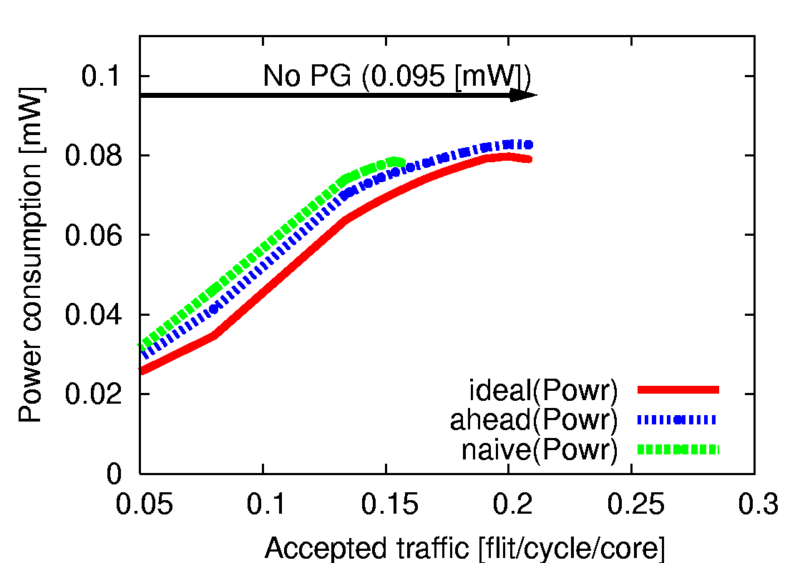
Breakeven point: leakage reduction
Breakeven point in literatures
  Execution unit in processor: 10 cycles
  It depends on circuit block size, clock freq, …
Leakage power reduction (@ uniform traffic)
The longer Tbreakeven reduces the opportunity of compensated sleep
Tbreakeven = 6 [cycle]
Tbreakeven = 14 [cycle]

Slide 31
Finer grain PG of NoC routers
Virtual channel (VC) level power gating
Packet routing scheme for VC-level PG
  All packets use VC#0 when they are injected to NoC
  VC number is increased when the packet conflicts
VC#0
VC#0
VC#0
VC#1
VC#1
VC#1
Only VC#0 is used if workload is low
VC#2
VC#2
VC#2
Router (a)
Router (b)
Router (c)

Slide 32
Finer grain PG of NoC routers
Virtual channel (VC) level power gating
Packet routing scheme for VC-level PG
  All packets use VC#0 when they are injected to NoC
  VC number is increased when the packet conflicts
All VCs are activated if workload is high
VC#0
VC#0
VC#0
VC#1
VC#1
VC#1
VC#2
VC#2
VC#2
Router (a)
Router (b)
Router (c)
High peak performance of VCs with the least leakage power

Slide 33
Buffer design: Registers or SRAMs
It depends on buffer depth, not width
  Depth > 32-flit → Buffers are design with SRAMs
  Otherwise → Buffers are design with registers
ARBITER
X+
FIFO
X+
In our design:
Buffer depth is 4-flit
X-
X-
FIFO
Y+
FIFO
Y+
FIFO buffers are design with registers
Y-
FIFO
Y-
5x5 XBAR
CORE
FIFO
CORE

Slide 34
Leakage power calculation
Power estimation flow:
  Perform the network simulation
  Obtain the length of every sleep during the simulation
  Ave. leakage of each sleep is estimated according to its length, based on “sleep duration vs. leakage” graph
Leakage reduction (Tbreakeven = 6)
Sleep duration vs. leakage power

Slide 35
Look-ahead method: the 1st hop?
Look-ahead for Router 3, Router 4, Router 5, …
Look-ahead for Router 1 and Router 2
Network interface (NI) performs look-ahead
  Packet construction takes several clock cycles
  NI of source node can perform “look-ahead”
Look-ahead!!
Look-ahead!!
Src
Router (1)
Router (2)
Router (3)
Router (4)
Dst
Look-ahead!!
Src
Router (1)
Router (2)
Router (3)
Router (4)
Dst

Slide 36
Look-ahead method:Adaptive routing
Routing algorithms
  Deterministic routing → routing path is predictable
  Adaptive routing → path is dynamically changed
Adaptive routing
  It is difficult to predict the routing path
  Look-ahead wakeup sometimes fails
  Eg., Asserting wakeup signals to wrong input channels
An extension for adaptive
  At low workload,
  Using the output selection function (OSF) that tries to use the same output channel → wakeup rarely fails
We used “deterministic routing”, because it is popular in simple NoCs

